Slide 1
Visiting Poverty Scholars Program
2025 Call for Applicants
April 11, 2025
Notes:
Becca:
Hello and thank you for joining us for our overview of the Institute for Research on Poverty’s Visiting Poverty Scholars Program Application Process

Slide 2
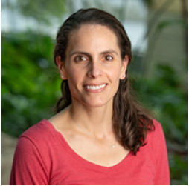
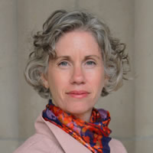
Welcome
SARAH HALPERN-MEEKIN
DIRECTOR, INSTITUTE FOR REASEARCH ON POVERTY
REBECCA SCHWEI
RESEARCH AND POLICY COORDINATOR, INSTITUTE FOR RESEARCH ON POVERTY
Notes:
Becca: ​
I’m Rebecca Schwei, the Research and Policy Coordinator at IRP. I’ll be your host throughout our webinar along with IRP’s Director, Sarah Halpern-Meekin. ​
​

Slide 3
Agenda
Overview of Program Goals & Activities
Overview of IRP
Overview of US Collaborative of Poverty Centers
Application Process
Application Resources
Q & A
Wrap Up and Closing
Notes:
Becca:
I’ll start with a brief walkthrough of the agenda.
Sarah will begin with an overview of the goals and activities of the Visiting Poverty Scholars Program. Then she will provide an overview of IRP as well as each member institute of the U.S. Collaborative of Poverty Centers. Finally, I’ll walk you through the logistics of the application process and direct you to where to find additional application resources. We then shift to any questions we have received throughout the webinar.
You can submit your questions using the Q&A function at any point throughout the webinar.
From here, I’ll hand it over to IRP’s Director, Sarah Halpern-Meekin. In addition to directing the Institute for Research on Poverty, Dr. Halpern-Meekin is a Professor in the Department of Human Development and Family Studies as well as at the La Follette School of Public Affairs. She is a sociologist whose research focuses on family, adolescence, social policy and the welfare state, class and inequality, and qualitative methods.

Slide 4
Program Goal
Enhance the research interests and resources available to poverty scholars from economically disadvantaged backgrounds
Notes:
Sarah:
Good afternoon. I’m so excited to introduce our Visiting Poverty Scholars program. IRP has run this program since 1998, over 25 years.
Our goal is to enhance the research interests and resources available to poverty scholars from economically disadvantaged backgrounds
Over 84 scholars have participated to date; many have maintained an ongoing relationship with IRP and have made important contributions to poverty-related research. Examples include
Christina Cross now at Harvard,
Leah Hamilton now at Appalachian State University,
Roberto Gonzales now at University of Pennsylvania,
Bradley Hardy now at Georgetown,
Michael Stoll now at UCLA and
Andria Smythe now at Howard University
The Visiting Scholars program seeks to Enhance the research interests and resources available to poverty scholars from economically disadvantaged backgrounds
.

Slide 5
Program Activities
Visit IRP or any one of its Collaborative of Poverty Center partners for one week to
Interact with the center’s resident faculty
Present a poverty-related seminar
Become acquainted with center staff and resources
Notes:
Sarah:
With those goals in mind, IRP provides travel and expenses so that scholars can visit IRP or any one of its Collaborative of Poverty Center partners for one week to
interact with faculty,
present a poverty related seminar of their choosing, and
get to know the center’s staff and resources.
These visits are a terrific way for scholars – particularly junior scholars – to present their research to a group of engaged interdisciplinary poverty scholars and receive thoughtful feedback on their work. Visits also provide an opportunity to build relationships with resident faculty.

Slide 6
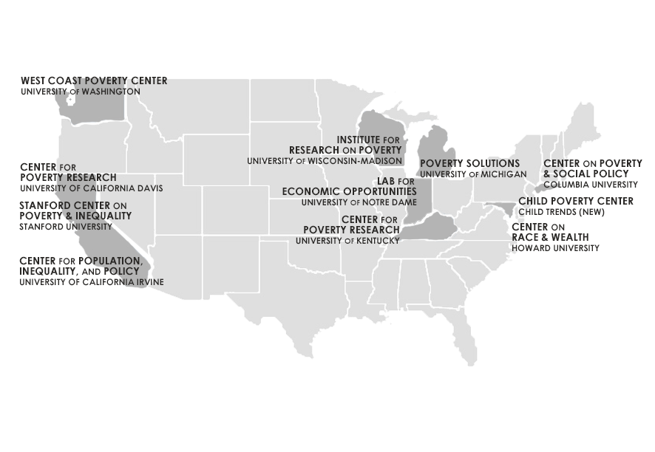
US Collaborative of Poverty Centers
Notes:
Sarah:
Visiting Scholars have the chance to visit one of the 11 poverty centers that are part of the U.S. Collaborative of Poverty Centers. Applicants are asked to rank their preferences on which centers they would like to visit in their application materials. You can list up to three.
To give you a better sense of your options, I’ll spend the next 10 minutes or so giving an overview of each center.

Slide 7
Institute for Research on Poverty
Located within the University of Wisconsin-Madison
Director: Sarah Halpern-Meekin
https://www.irp.wisc.edu/
300+ on and off-campus affiliates
National Research Center on Poverty and Economic Mobility
Leads the Collaborative of Poverty Centers
Notes:
Sarah:
I’ll start us off with IRP.
IRP is the longest serving poverty center and currently has over 300 affiliates both on and off the UW-Madison campus.
As the National Research Center on Poverty & Economic Mobility funded by the U.S. Department of Health and Human Services, IRP coordinates the U.S. Collaborative of Poverty Centers (CPC).
IRP and its partner centers support and train poverty and economic mobility scholars and provide relevant, cutting-edge research on a wide range of topics with the goal of improving the effectiveness of public policies to reduce poverty and its consequences. Some of IRP’s main research areas are early care and education, child maltreatment, child support, and fatherhood programs.

Slide 8
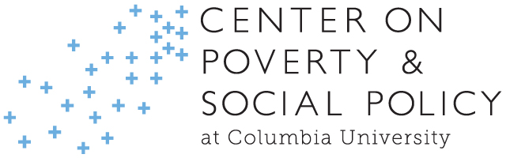
Center on Poverty & Social Policy
Columbia University
Director: Christopher Wimer
https://www.povertycenter.columbia.edu/
56 affiliates
Example Areas of Focus:
  Poverty Trends and Measurement
  Tax Credits
Notes:
Sarah:
The Center on Poverty and Social Policy at Columbia University in New York City is directed Chris Wimer. They have 17 affiliates at Columbia and 39 off campus. CPSP produces cutting-edge research to advance the understanding of poverty and the role of social policy in reducing poverty and promoting opportunity, economic security, and individual and family wellbeing in New York City and the United States.
Their work mainly focuses on
historical poverty trends and measurement,
youth poverty,
food insecurity and hunger,
anti-poverty policies and programs including tax credits.
Their work tracking poverty rates during the COVID-19 pandemic and the expansion of the Child Tax Credit have been widely publicized.

Slide 9

Center on Race and Wealth
Howard University
Director: Haydar Kurban
https://coascenters.howard.edu/research-centers/center-race-and-wealth
Example Areas Focus:
  Asset Building
  Wealth Accumulation
  Racial Wealth Disparities
Notes:
Sarah:
Next, we have the Center on Race and Wealth at Howard University in Washington, D.C., directed by Haydar Kurban. Dr. Kurban is an expert in racial and wealth equity, payday loans, financial security, retirement, family stability, gentrification, vulnerable populations and climate change, and education property taxes.
This center primarily focuses on
asset building,
wealth accumulation, and
racial wealth disparities.

Slide 10

Poverty Solutions
University of Michigan
Director: Luke Shaefer
https://poverty.umich.edu/
150+ affiliates
Example Areas & Projects of Focus:
  Detroit Partnership on Economic Mobility
  Flint Rx Kids
  Understanding Communities of Deep Disadvantage
Notes:
Sarah:
Poverty Solutions at the University of Michigan is directed by Luke Shaefer.
Poverty Solutions’ mission is to partner with communities and policymakers to find new ways to prevent and alleviate poverty through action-based research.
In addition to producing research, and hosting events, Poverty Solutions runs a series of action-based research projects which focus on partnerships, pilots, and large-scale programs to help inform the most effective strategies to prevent and alleviate poverty. Through these projects, Poverty Solutions engages with policymakers in Detroit, Flint, Ann Arbor and at the state level.
Poverty Solutions has a large network of affiliates, with over 150 on and off-campus.

Slide 11

Center for Poverty Research
University of Kentucky
Director: James Ziliak
https://cpr.uky.edu/
24 affiliates
Example Areas of Focus:
  Food Assistance Programs
  Food Insecurity
Notes:
Sarah:
Moving on to the University of Kentucky, the University of Kentucky Center for Poverty Research is directed by Jim Ziliak.
The center has 24 affiliates and primarily focuses on food assistance and food insecurity. Visiting this CPC would be a great fit for any researcher who’s interested in domestic food insecurity and hunger.

Slide 12

Wilson Sheehan Lab for Economic Opportunities
University of Notre Dame
Directors: William Evans, Heather Reynolds, James Sullivan
https://leo.nd.edu/
106 affiliates
Example Projects & Areas of Focus:
  Education
  Criminal Justice
  Healthcare
Notes:
Sarah:
Next up, the Wilson Sheehan Lab for Economic Opportunities or LEO at the University of Notre Dame, is directed by Bill Evans, Heather Reynolds, and Jim Sullivan.
With over 100 affiliates, the center focuses on criminal justice, economic mobility, education, health, and housing.
Most of LEO’s work focuses on connecting researchers with practitioners to conduct impact evaluations. They are currently partnering on more than 100 projects around the country. In 2024, Notre Dame launched a university-wide Poverty Initiative to develop and advance innovative solutions to help vulnerable populations and to train a new generation of leaders committed to the fight against poverty.

Slide 13

Stanford Center of Poverty and Inequality
Stanford University
Director: David Grusky and Sara Kimberlin
https://inequality.stanford.edu/
160 on-campus affiliates, 420 national and international affiliates
Example Projects & Areas of Focus:
  Annual Poverty and Inequality Report
  Social Mobility
  American Voices Project
Notes:
Sarah:
Turning to our CPCs on the West coast, the Stanford Center on Poverty and Inequality at Stanford University has 580 affiliates.
The center is organized by 9 research labs that focus on topics ranging from social mobility, to tax policy, to housing and homelessness.
For example, the Voices Lab manages the American Voices Project (AVP), an innovative new research infrastructure for collecting and analyzing mixed-methods data across diverse research topics. The AVP is the country’s first large-sample, nationally representative, mixed methods data platform that makes it possible to discover what people are thinking, feeling, doing, and experiencing.

Slide 14

Center for Poverty & Inequality Research
University of California, Davis
Directors: Marianne Page & Jacob Hibel
https://poverty.ucdavis.edu/
50 Affiliates
Areas of Focus:
  Non-traditional Safety Net (Education and Health Programs)
  Labor Markets and Poverty
  Children and Intergenerational Transmission of Poverty
  Immigration Policy and Poverty
Notes:
Sarah:
The Center for Poverty and Inequality Research at UC Davis is directed by Marianne Page and Jacob Hibel.
They have 50 affiliates and focus on
the non-traditional safety net programs like education and health programs,
labor markets and poverty
children and the intergenerational transmission of poverty, and
The intersection of immigration and poverty.

Slide 15
Center for Population, Inequality, & Policy
University California, Irvine
Directors: Tim Bruckner, David Neumark and Jade Jenkins
https://www.cpip.uci.edu/index.php
72 Affiliates
Example Areas of Focus:
  Child and Adolescent Development
  Criminal Justice and the Life Course
  Migration
Notes:
Sarah:
The Center for Population, Inequality and Policy at UC Irvine is directed by Tim Bruckner, David Neumark, and Jade Jenkis.
It is focused on advancing research on socioeconomic factors that directly impact inequality. Faculty in the center investigate the causes and consequences of this inequality as well as policies and other strategies designed to improve well-being of the less advantaged – including employment, education, health, housing and income.
The center’s research areas include:
Child and Adolescent Development
Maternal and Infant Health
Criminal Justice and the Life Course
Migration
Institutions and Human Capital; and
Population Data Science and Methodology

Slide 16

West Coast Poverty Center
University of Washington
Director: Jennifer Romich
http://depts.washington.edu/wcpc/
46 affiliates
Example Areas & Projects of Focus:
  Child & Family Well-Being
  Household Budgets
  Income Supports
Notes:
Sarah:
Last but not least, the West Coast Poverty Center at the University of Washington is directed by Jennifer Romich and has 46 affiliates.
Dr. Romich is an expert on low-income workers, household budgets and families’ interactions with public policy.
The West Coast Poverty Center works to bridge the gaps between anti-poverty research, practice, and policy by connecting scholars, policymakers and practitioners; facilitating important social policy research; magnifying the reach of new knowledge; and fostering the next generation of anti-poverty scholars.
Much of the West Coast Poverty Center’s work focuses on income supports and household budgets for low-income families.
WCPC engages regularly with their state and local governments on projects.
Now, I will hand it back over to Becca to talk more about the logistics of the application process.

Slide 17
Application Process: Eligibility
Ph.D.-holding, U.S.-based poverty scholar at any career level
From an economically disadvantaged background
  come from a low-income family;
  be from a family in which neither parent earned a four-year college degree;
  come from an underserved urban, rural, or farming community;
  have attended a high school with limited college preparatory curriculum;
  have attended a high school in a high poverty concentration school district;
  have other economic family circumstances that have impacted the applicant’s educational opportunities.
Notes:
Becca:
Thank you, Sarah, for that terrific overview. For the second half of this webinar, I’ll run through the logistics of the application process and share where you can find application resources.
To be eligible for the Visiting Scholars Program, applicants must be Ph.D.-holding, U.S.-based scholars at any career levels and be from an economically disadvantaged background. To meet the economically disadvantaged definition, applicants must meet one or more of the following criteria:
come from a low-income family;
be from a family in which neither parent earned a four-year college degree;
come from an underserved urban, rural, or farming community;
have attended a high school with limited college preparatory curriculum;
have attended a high school in a high poverty concentration school district;
have other economic family circumstances that have impacted the applicant’s educational opportunities.
Applicants will be asked to describe how they meet this definition of economically disadvantaged in their application materials.

Slide 18
Application Process: Funding
Up to 4 scholars will be selected to visit a Poverty Center in the 2025-2026 academic year
Funding covers:
  Transportation
  Lodging
  Meals
Notes:
Becca:
Up to four scholars will be selected to visit a Poverty Center during the 2025-2026 Academic Year
IRP will cover transportation, lodging, and meals during the five-day in-residence visit.

Slide 19
Application Process: Application
Complete online Application Form:
Upload as 1 pdf:
  2-page letter
    describe poverty research interests and experiences
    Indicate the CPC institutions that you are applying to (up to 3, ranked by preference)
  CV
  2 examples of poverty-related written materials
Notes:
Becca:
To apply,
Fill out the online Application Form with https://www.irp.wisc.edu/visiting-poverty-scholars-program-2025-2026-application-deadline-4-30-2025-1159-p-m-cdt/
Your contact information
A brief bio
Your ranking of up to 3 poverty centers you’d like to visit.
a brief description of how you meet the definition of having an economically disadvantaged background (note that this information is used in the initial eligibility process and, once eligible, is not used in the selection process, nor is it shared with the poverty centers you have ranked as top choices)
The online form is also where you will upload the following. We ask that you put it all into 1 pdf:
- a 2-page single spaced letter that describes your poverty research interests and experience and indicates the CPC institutions that you are applying to visit and why those centers are a good fit for you.
your CV and
2 examples of your poverty-related written material.

Slide 20
Application Process: Timeline
April 30, 2025: Deadline for proposal receipt
Mid-May 2025: Notification of award
2025-2026 Academic Year: Dates for Visit (flexible)
Notes:
Becca:
Proposals must be submitted by April 30, 2025.
Awardees will be notified in late May 2025, and
visits must occur during the 2025-2026 Academic Year.
IRP will make every effort to match selected scholars to their top choice of poverty center. Once selected, IRP will connect the scholar with a primary contact at the chosen poverty center. From there, the scholar will work directly with the poverty center contact to identify dates for the visit and develop an itinerary.
Note that all travel arrangements need to be made through IRP and must follow UW-Madison travel policies. IRP will pay directly for flight and hotel costs and will reimburse the scholar for their meals up to UW-Madison travel rules.

Slide 21
Application Resources
Learn more about the Visiting Scholars Program at: https://www.irp.wisc.edu/visiting-poverty-scholars-program/
Get application instructions at: https://www.irp.wisc.edu/visiting-poverty-scholars-program-2025-2026-application-deadline-4-30-2025-1159-p-m-cdt/
Send questions to:
irpapply@ssc.wisc.edu
Sign up for IRP email announcements at: https://www.irp.wisc.edu/connect/
Notes:
Becca:
The IRP website is the best source for information about the Visiting Scholars Program. On that page, you’ll be able to learn about the program, see past visiting scholars and access the call for applications.
https://www.irp.wisc.edu/visiting-poverty-scholars-program/
https://www.irp.wisc.edu/visiting-poverty-scholars-program-2025-2026-application-deadline-4-30-2025-1159-p-m-cdt/
Please direct any questions you have after this webinar to the email address in the chat: irpapply@ssc.wisc.edu.
If you’re not already on our email list, you can use the final link to sign up for the IRP email announcements, which will keep you up to date on our latest resources, events, and news, including calls for research funding and training opportunities.
https://www.irp.wisc.edu/connect/

Slide 22
Q & A
Put your questions in the Chat or the Q & A box
Notes:
Becca:
Now I’d like to open the floor for any questions. Please submit questions directly in the chat.
If asked about selection process:
IRP staff will first do a completeness review to make sure all required information was submitted:
Online form filled out
Materials submitted including
2 page letter
CV
2 examples of work
Meeting definition of economically disadvantaged
A panel of IRP affiliates and staff review the applications
Score based on
the relevance of research to topics of poverty and inequality
applicant's record of scholarly engagement and potential for scholarly achievement
Clarity of the poverty centers selected and why they are a good fit for applicant
Top candidates sent to poverty centers who choose

Slide 23
Wrap up & closing
Thank you!
Notes:
Becca: Thank you all for attending the 2025 Visiting Poverty Scholar Application webinar.​
​
We look forward to reviewing your applications!

